Slide 1

Netflix: Latest Releases around the Globe Group 9 Charles Robinson Samuel Fonseca Kimberly Flores Kiran Mundae

Slide 2
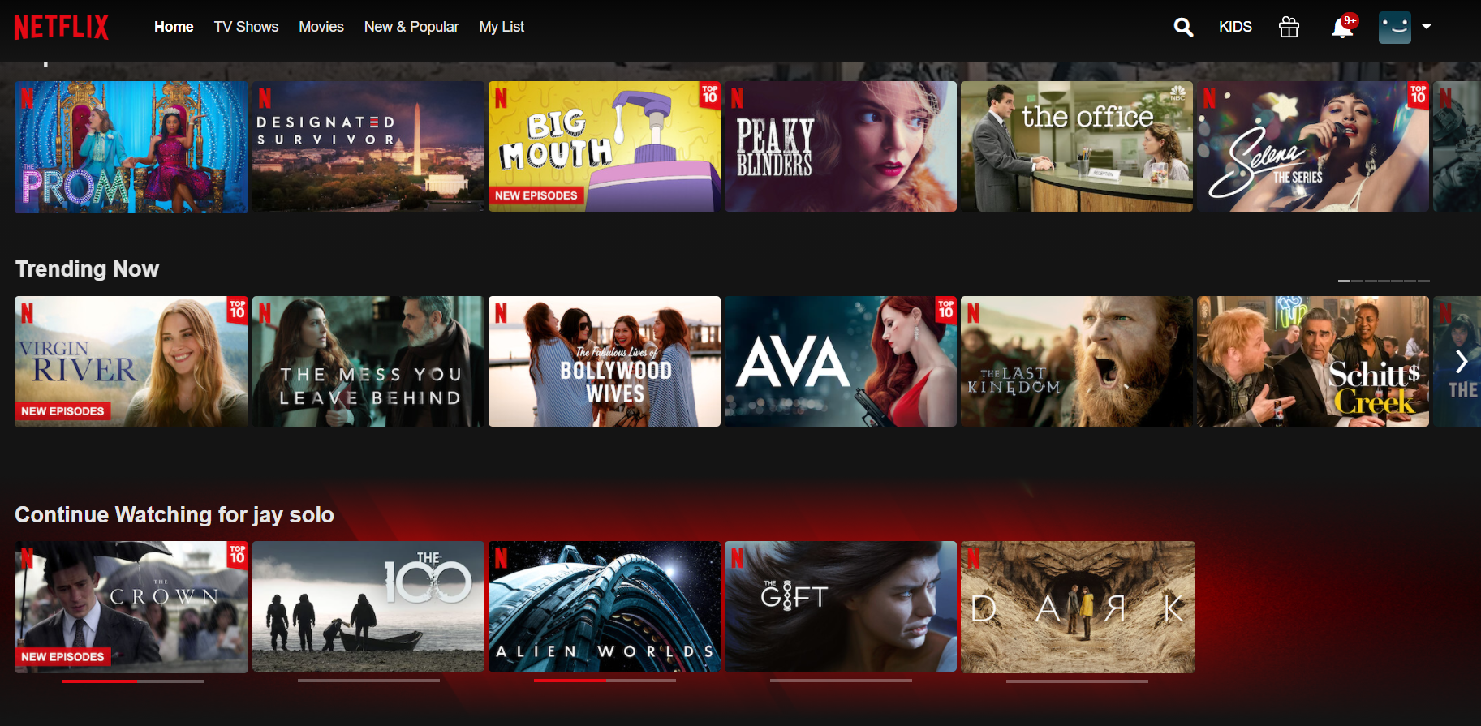

Slide 3




Areas of Interest:
Movie genres in different countries
Average ratings in different countries
Number of movies released in each country

Slide 4

First Steps:
Used Heroku to hold our SQL tables
Connected Heroku Server to local Postgres
Ensured that all SQL tables were always up to date

Slide 5
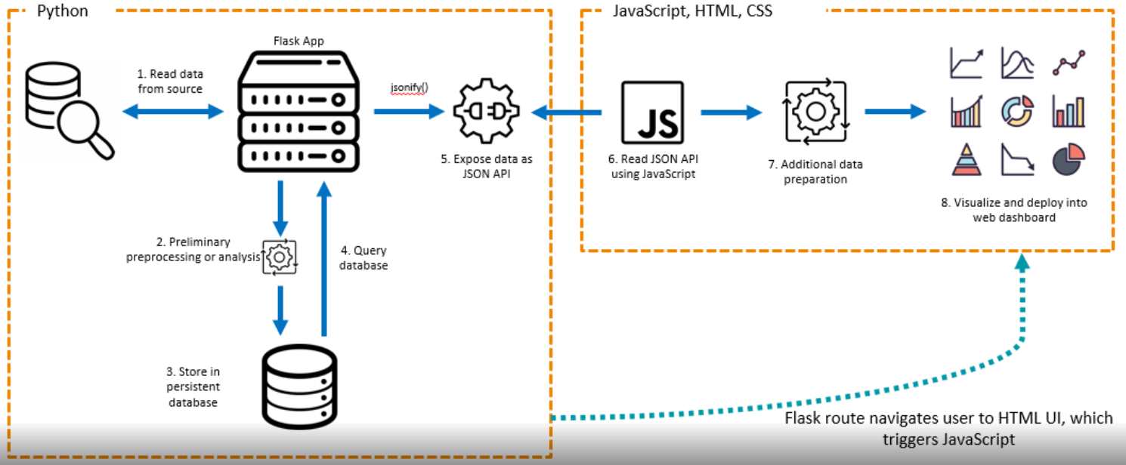
Architecture Design
Notes:
Discuss design. Initial steps taken by the team. Why?

Slide 6
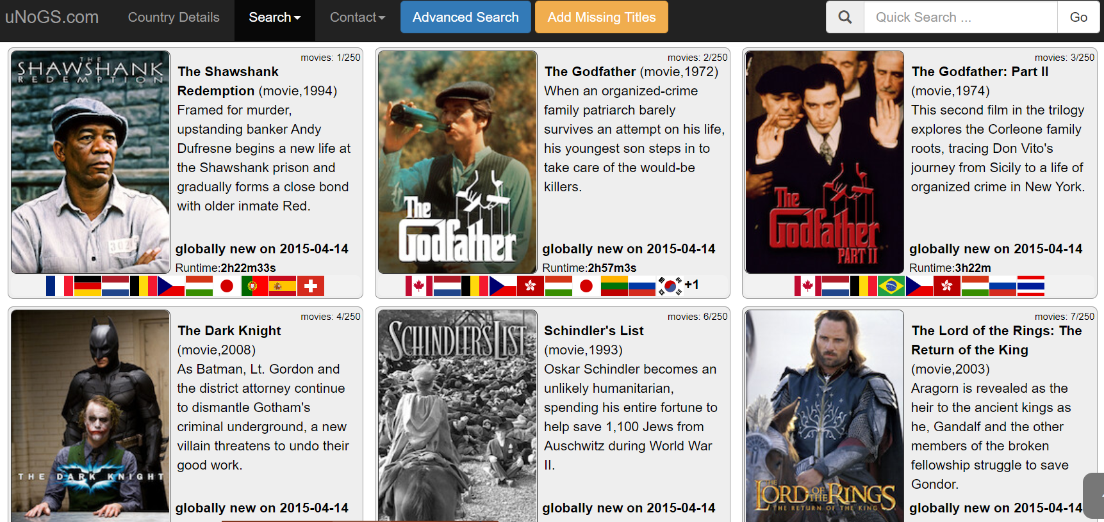
About the API
uNoGs Global Netflix Search:
Netflix title information
IMDB Information
Season and Episode details
Pros:
Intuitive
Extensive information on titles
Cons:
Not a free service
Limited information on all countries

Slide 7
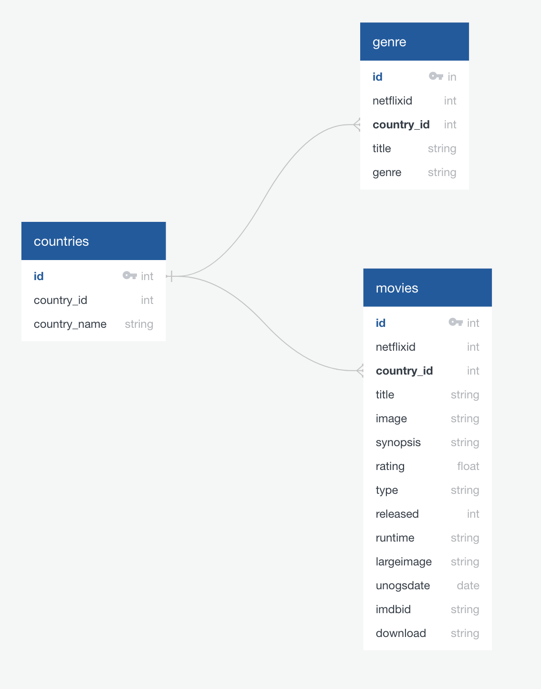
Data Gather, Clean Up, & Storage
Main calls made to the API:
Countries with latest active data
Latest films/titles by country
IMDB info per films/titles
Data Clean Up:
Assign primary genre to films/titles
Data Storage:
Three tables were generated
Notes:
Data Clean Up: This was needed because many genres came back with primary and subgenres. But we wanted to be able to count that genres later for visualization.

Slide 8
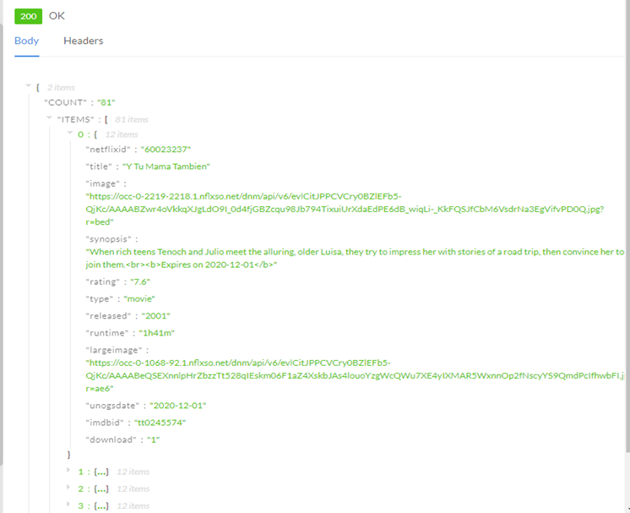
Sample Response

Slide 9
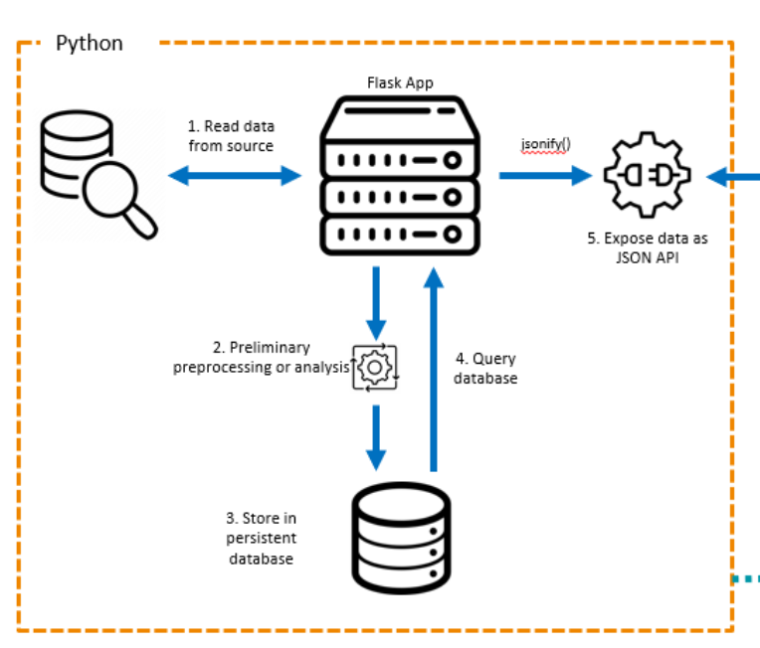
Flask Deployment
Through the flask application forms the connection to Heroku to upload tables consistently
Flask application routes:
Countries
Latest Releases
Genres
Update data

Slide 10

Data Limitations:
To ensure that we stayed within the API call limit that was purchased we did not pull data for a longer time frame.
Country naming inconsistencies was an issue

Slide 11

Next Steps:
Create an application that will pull current weeks data automatically instead of at the push of a button
Create a dropdown where user can select releases from the past 30 days, 3 months, 6 months etc…
Show more details about each new release – synopsis, year released etc..

Slide 12

Questions

Slide 13
Sources:
Netflix API Data:
https://unogs.com/
Leaflet Map:
https://unpkg.com/leaflet@1.6.0/dist/leaflet.js
GeoJSON:
https://raw.githubusercontent.com/datasets/geo-countries/master/data/countries.geojson
D3-force:
https://github.com/d3/d3-force
Nodes:
https://nodejs.org/en/download/
D3-drag:
https://github.com/d3/d3-drag
Youtube Tutorial Videos:
https://www.youtube.com/watch?v=NTS7uXOxQeM&t=111s
https://www.youtube.com/watch?v=y2-sgZh49dQ

